Slide 1



Les 4
Bacteriën zichtbaar maken

Slide 2


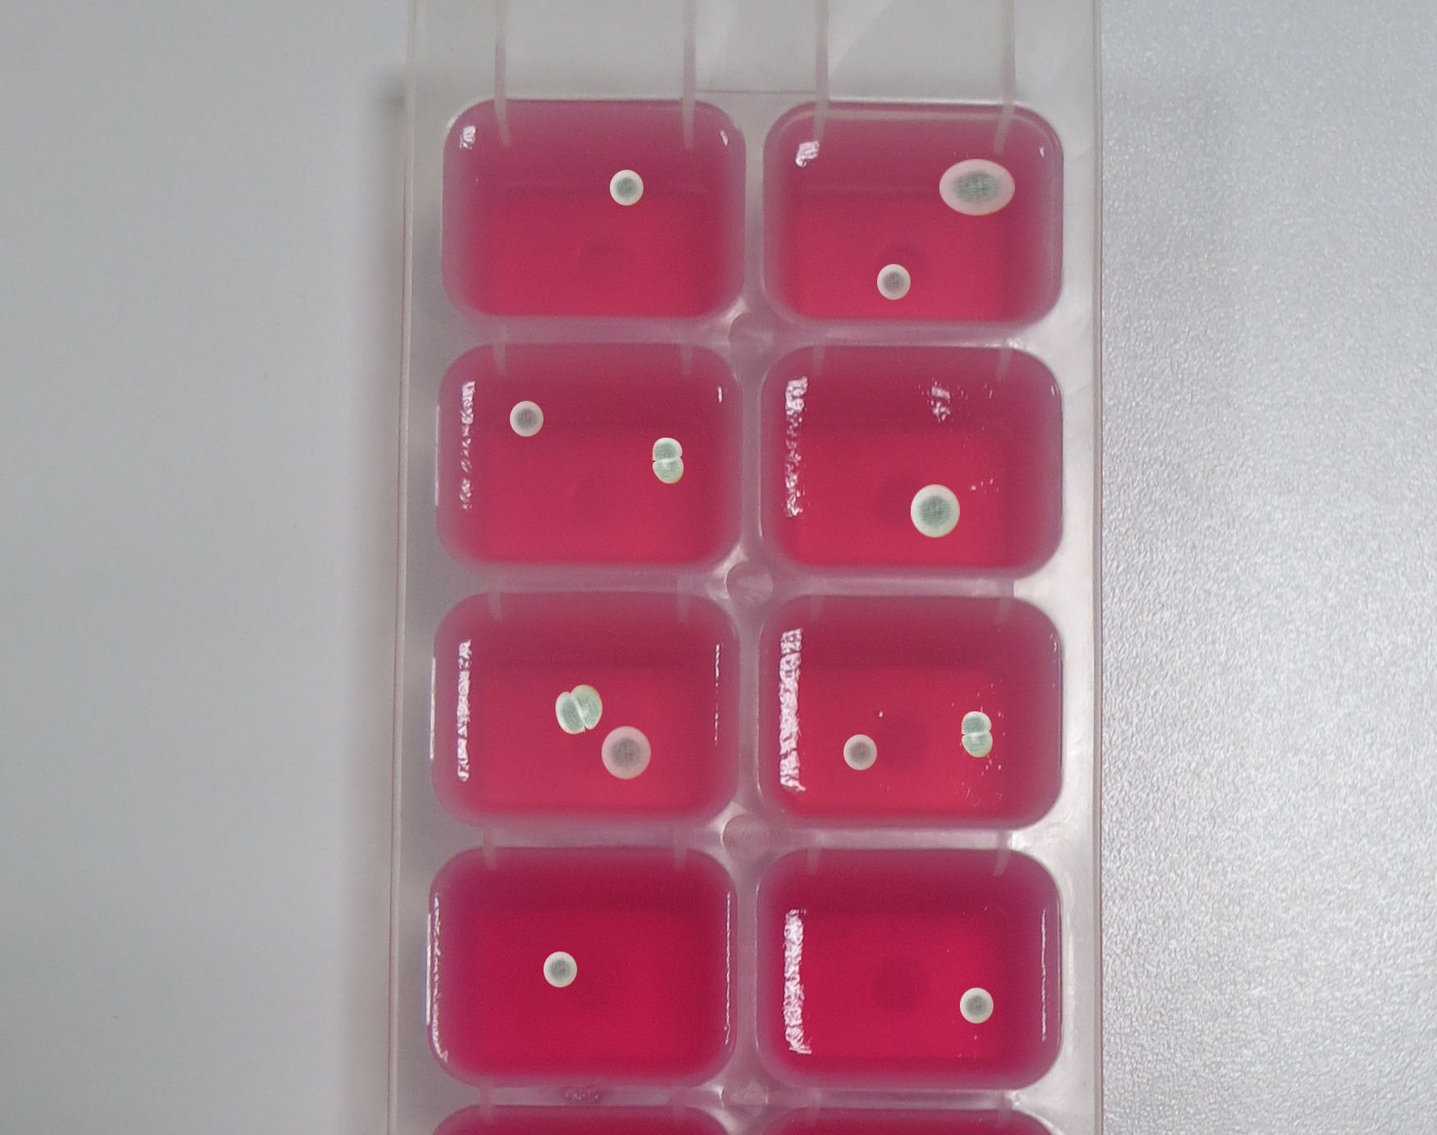
De organismen die ontstaan zijn op de agar kubussen

Slide 3
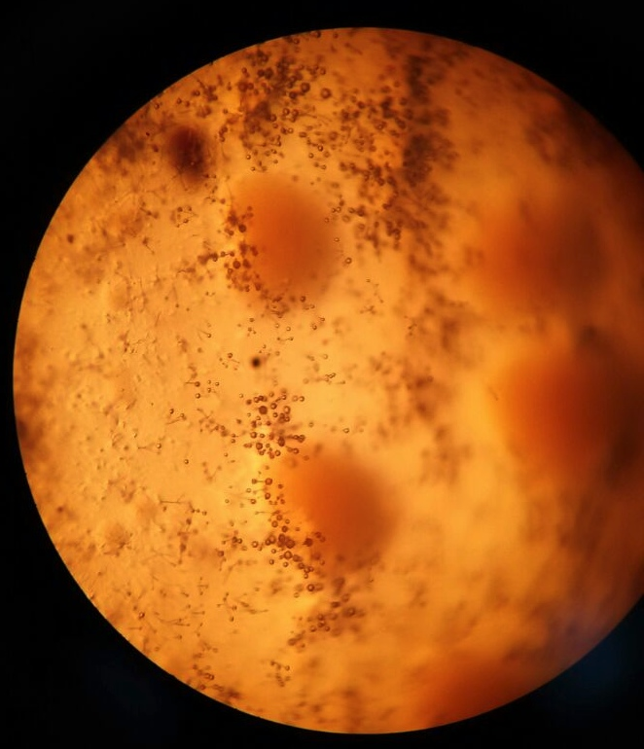
Licht Microscoop

Slide 4
SEM
1000x (20µm)

Slide 5
SEM
2400x (10µm)

Slide 6
SEM
5000x (5µm)

Slide 7
SEM
5000x (5 µm)

Slide 8
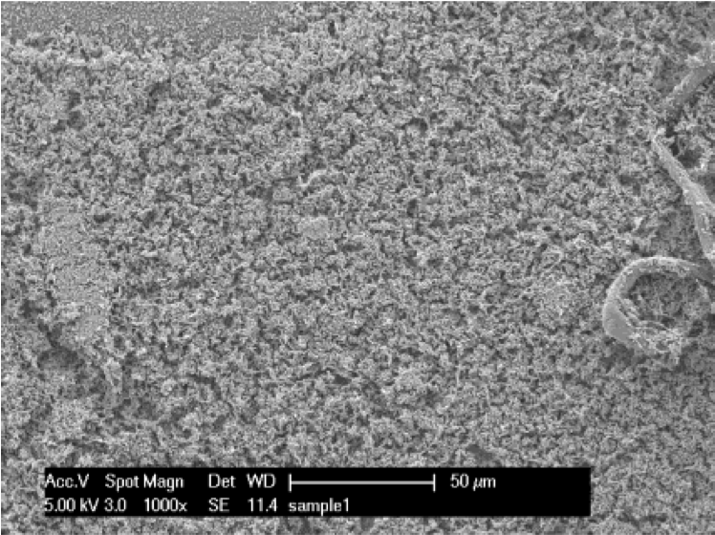
Gezonde E. Coli Bacterie Cellen
1000x (50µm)
(Muskin et al., 2008)

Slide 9
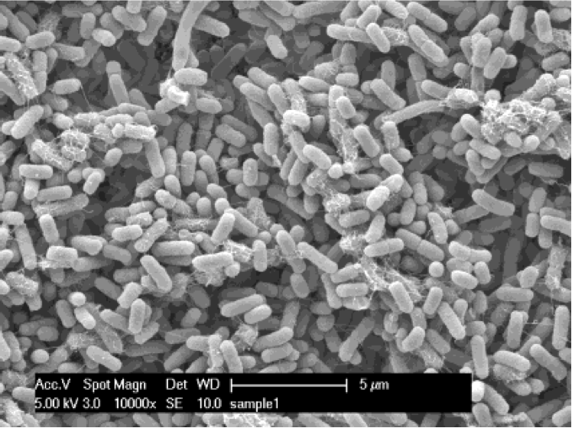
Gezonde E. Coli Bacterie Cellen
10000x (5µm)
(Muskin et al., 2008)

Slide 10
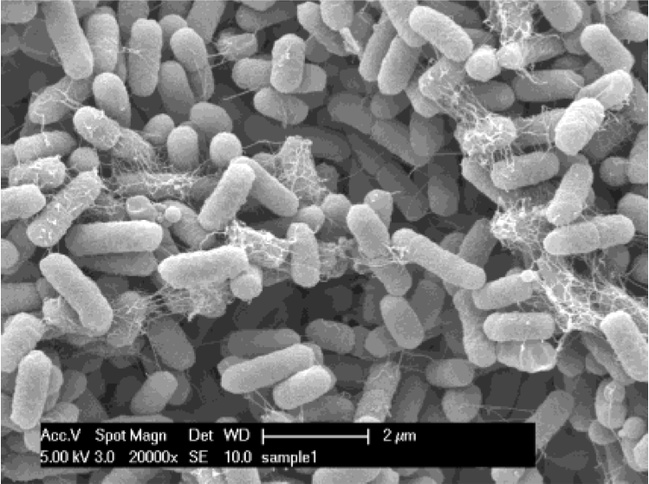
SEM: E. Coli Bacterie Cellen
20000x (2µm)
(Muskin et al., 2008)

Slide 11
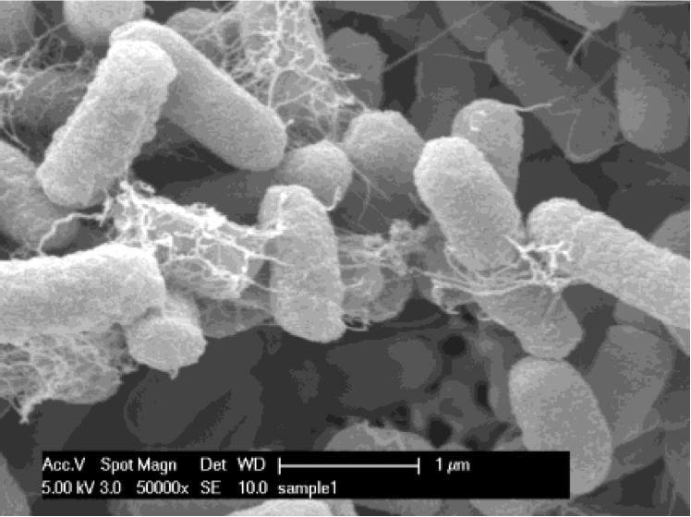
Gezonde E. Coli Bacterie Cellen
50000x (1µm)
(Muskin et al., 2008)

Slide 12
Licht Microscoop vs.
Electron Microscoop
 | Licht microscoop | Electron microscoop
Lichtbron | Zichtbaar licht (400-700 nm) | Electronenbundel (0,005 nm)
resolutie | 0,25 µm | 0,05 nm
Maximale vergroting | 1400x | 1,000,000 x

Slide 13
Limiet van de
Licht Microscoop

Slide 14
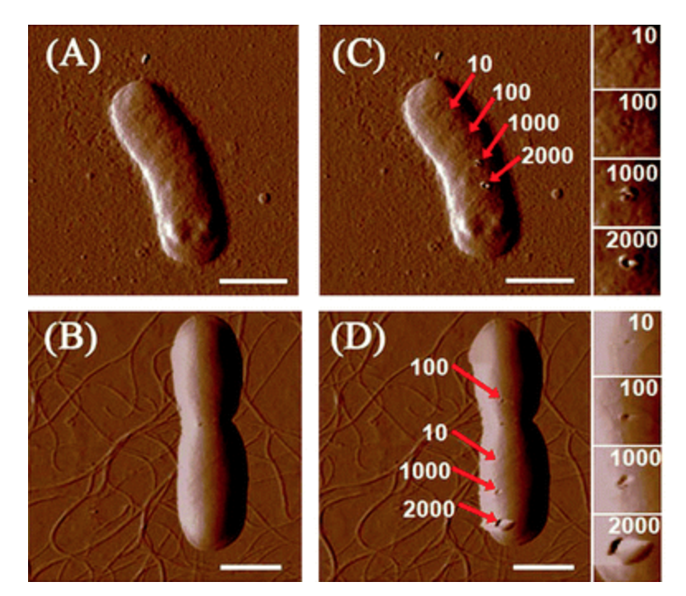
AFM beelden van bacteria
(Liu et al., 2010).

Slide 15
References:
Liu, S., Ng, A. K., Xu, R., Wei, J., Tan, C. M., Yang, Y., & Chen, Y. (2010). Antibacterial action of Dispersed single-walled carbon nanotubes on Escherichia coli and Bacillus subtilis investigated by atomic force microscopy. Nanoscale, 2(12), 2744-2750.
Muskin, J., Wattnem, J., Ragusa, M. and Hug, B. (2008). Real Science or Marketing Hype: Student-Designed Experiments Test the Antimicrobial Effects of Silver Nanoparticles. The Science Teacher, 75(4), 57-61.

